Slide 1

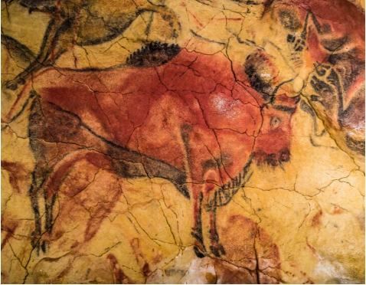
Prehistory
the time period before written records

Slide 2

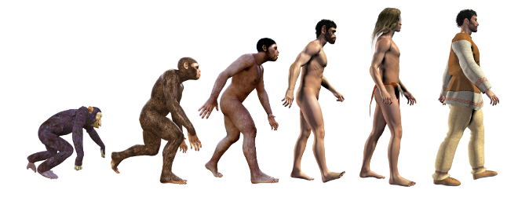
Anthropology
the study of humans and their development, including human culture and
human
behavior

Slide 3
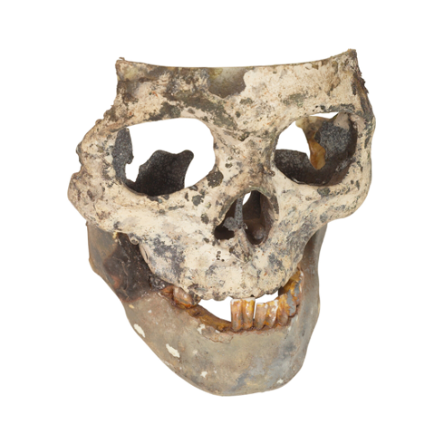
Hominid
early relatives to modern-day humans

Slide 4

Ancestor
relatives or family members who lived in the past

Slide 5
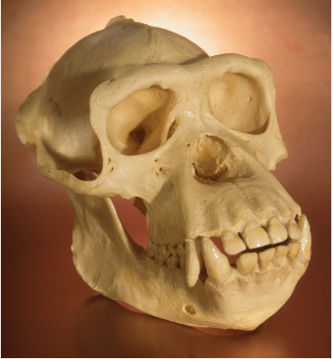
Australopithecus
“southern ape” and believed to be one of the first hominids capable of walking on two feet

Slide 6
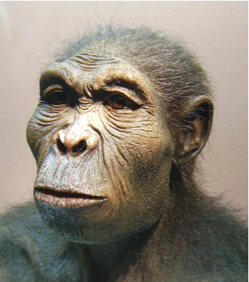
Homo habilis
“handy man” and believed to be one of the first hominids to create stone tools

Slide 7
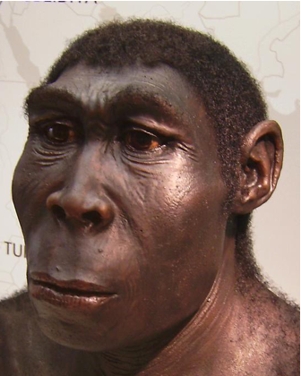
Homo erectus
“upright man” and believed to be the first hominid to walk on two feet full time, learn to control fire, and migrate outside of Africa

Slide 8

Homo sapiens
“wise man” and the group including modern-day humans, which is believed to be the first hominid to develop language

Slide 9
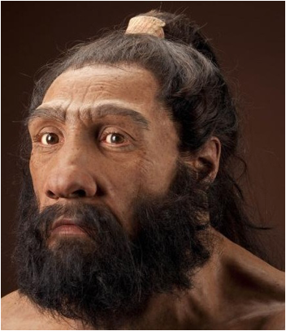
Neanderthals
the closest extinct hominid to humans who lived across Europe and central Asia, and believed to be the first hominid to bury their dead

Slide 10
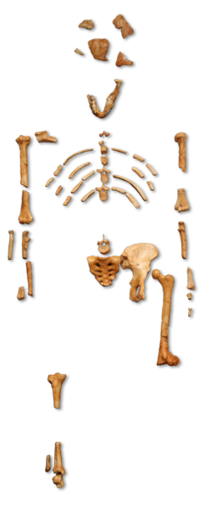
Lucy
Australopithecus whose remains are more than 3 million years old

Slide 11
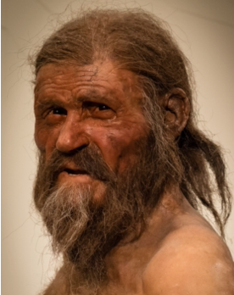
Otzi the Iceman
Homo sapiens from the Stone Ages who was discovered frozen in a glacier and is one of the oldest mummies in human history

Slide 12

Technology
the application of science and engineering to create tools that improve quality of life

Slide 13
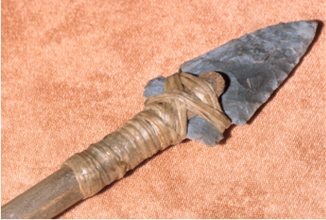
Tool
a handheld object that is designed to help complete a specific task

Slide 14
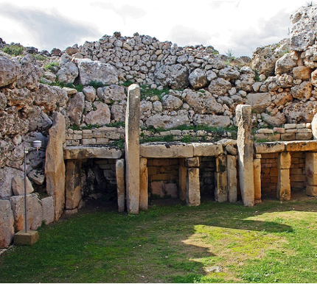
Stone Ages
period of time where humans invented and primarily used stone tools

Slide 15
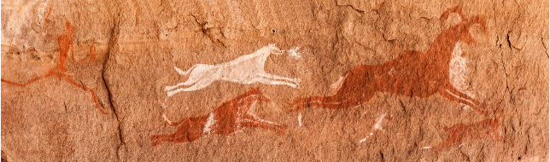
Paleolithic Era
Old Stone Age, which occurred circa 2.6 million years-10,000 years ago

Slide 16
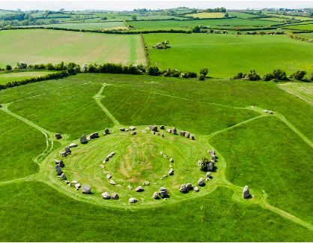
Neolithic Era
New Stone Age, which occurred c. 10,000 years ago + is associated with the shift from hunting and gathering to agriculture

Slide 17

Society
a group of people living together within a community

Slide 18
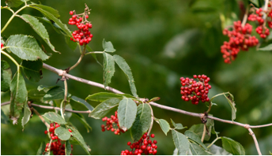
Hunter-Gatherers
people who hunt animals and gather wild plants to acquire food

Slide 19
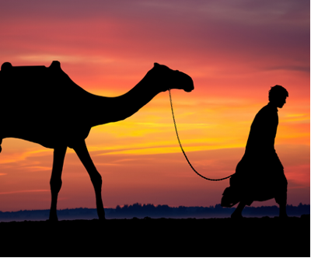
Nomads
people without a permanent home, either individually or as a community, who move from place to place

Slide 20
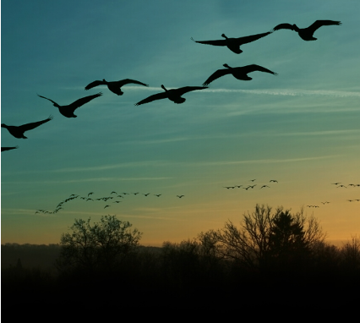
Migration
movement from one location to another, in order to establish a new permanent settlement

Slide 21
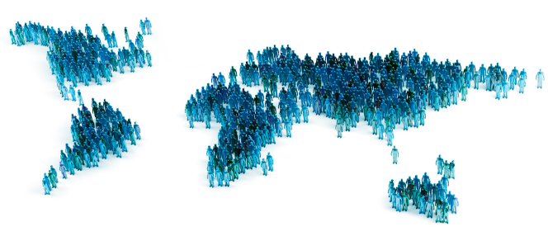
Population
the total number of people within a specific area, such as a
city, state, or country

Slide 22
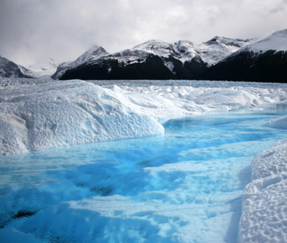
Ice Ages
time periods with consistently freezing temperatures throughout the world

Slide 23
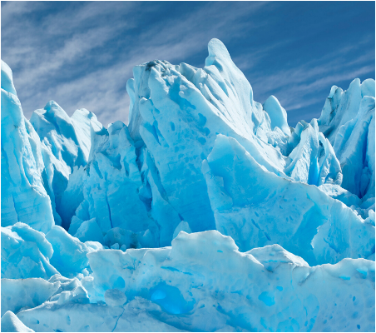
Glacier
a large mass of ice that covers a section of land

Slide 24
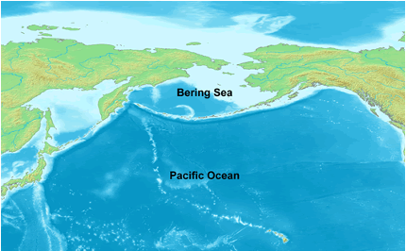
Bering Strait
a narrow passage of water located between Russia and Alaska, where it is believed that
humans crossed a frozen land bridge from Asia to North America during the Ice Ages

Slide 25
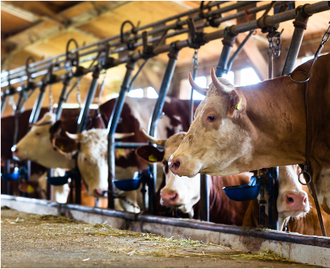
Domestication
planting foods and breeding animals that are useful for humans

Slide 26
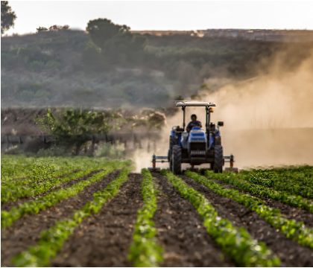
Agriculture
the process of farming

Slide 27
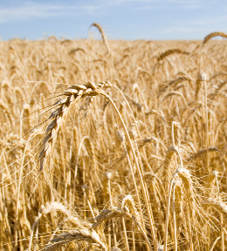
Agricultural Revolution
the large-scale shift from hunting/gathering to farming, which allowed humans to produce large quantities of food

Slide 28
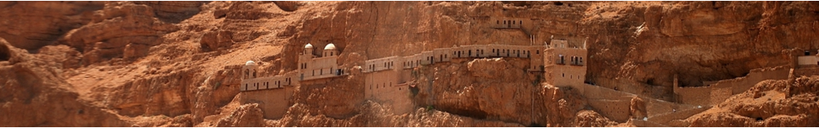
Jericho
prehistoric and current city near the Jordan River and Dead Sea, with its famous wall surrounding the area

Slide 29
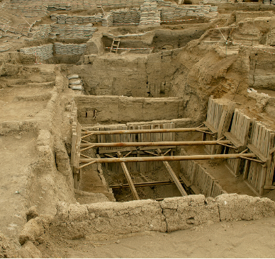
Catal Huyuk
prehistoric city located in modern-day Turkey, which is famous for its art and religious practices

Slide 30
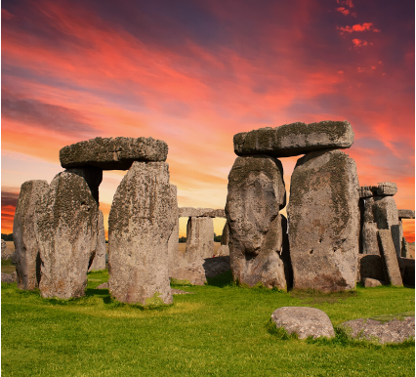
Stonehenge
a prehistoric monument in England, with purposes that are still unclear to historians today

