Slide 1
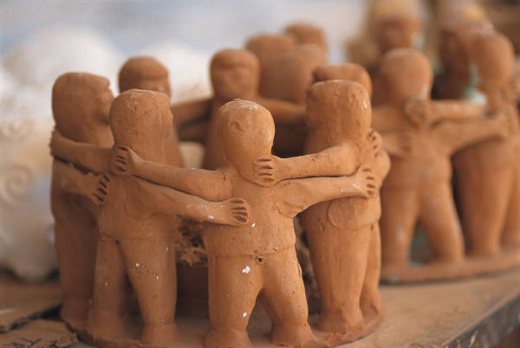
We Have an Important Job!
Mrs. Flickinger, Mrs. Plunk, Mrs. Melanese
I
Partners
I dreamed I stood in a studio,
And watched two sculptors there.
The clay they used was a child’s mind,
And they fashioned it with care.
One was a teacher; the tools used,
Were books and music and art.
One, a parent with guiding hands,
A gentle and loving heart.
Day after day the teacher toiled,
With a touch both deft and skilled.
The parent labored side by side,
And all the values filled.
And when at last their task was done,
They looked at what they’d wrought.
The beautiful shape of the precious child,
Could neither be sold nor bought
And each agreed it would have failed,
If one had worked alone.
For behind the parent stood the school,
And behind the teacher, home.

Slide 2
Philosophy
We believe in a holistic approach to teaching. We have high expectations for teaching the standards, but we also balance the curriculum with activities to teach confidence, self esteem, and problem solving. We believe our fourth and fifth graders are leaders of the school and provide opportunities to learn leadership skills.

Slide 3
Schedule
8:00-8:50 – Morning procedures and Novels
8:50 – 10:05 - Rotation 1
10:10 - 10:25 Recess
10:25 – 11:40 - Rotation 2
11:45 – 12:15 Lunch
12:20 - 1:35 Homeroom Rotation Instruction
1:40 – 2:00 Music, computers, planners, read aloud, clean up
2:00 Dismissal

Slide 4

Language Arts
Taught by Mrs. Flickinger
Houghton Mifflin –This book integrates reading and language. The literature selections motivate students to build skills and strategies in reading, writing, phonics, spelling, vocabulary, and grammar
Story Selections, Activities, technology integration, as well as large group and small group instruction are some of the strategies used to teach this reading series.
Spelling Packets due Friday. Test on Friday – 20 words
(one page per night)

Slide 5
Science/History/PE
Taught by Mrs. Melanese
CST 5th Grade Test
40% Fourth grade standards
60% Fifth grade standards
Textbooks, Science Journals, Science Lab
History – History of the United States (5th grade)
California History (4th grade)
Physical Education-
Tuesday and Thursday→ sports and skills building activities
Wednesday→Mile run

Slide 6
Math
Taught by Mrs. Plunk
enVision Math published by Pearson /Scott Foreman
Rigorous Curriculum- 20 Topics
Number Sense
Algebra and Functions
Measurement and Geometry
Statistics, Data Analysis, and Probability
Math Reasoning
Common Core adds an emphasis on problem solving, writing, and collaboration
Math homework every night
Pearsonsuccessnet.com– Access Math Book at Home

Slide 7
Binders
The key to success in rotation is ORGANIZATION
Please help your child keep his/her folder clean. Here are the guidelines
Pocket dividers: Five pocket dividers
Pencil Pouch - Scissors, glue stick, sharpener(optional), 2 pencils, correcting tool, and a box of colors (Twistables, Colored pencils, crayons)

Slide 8
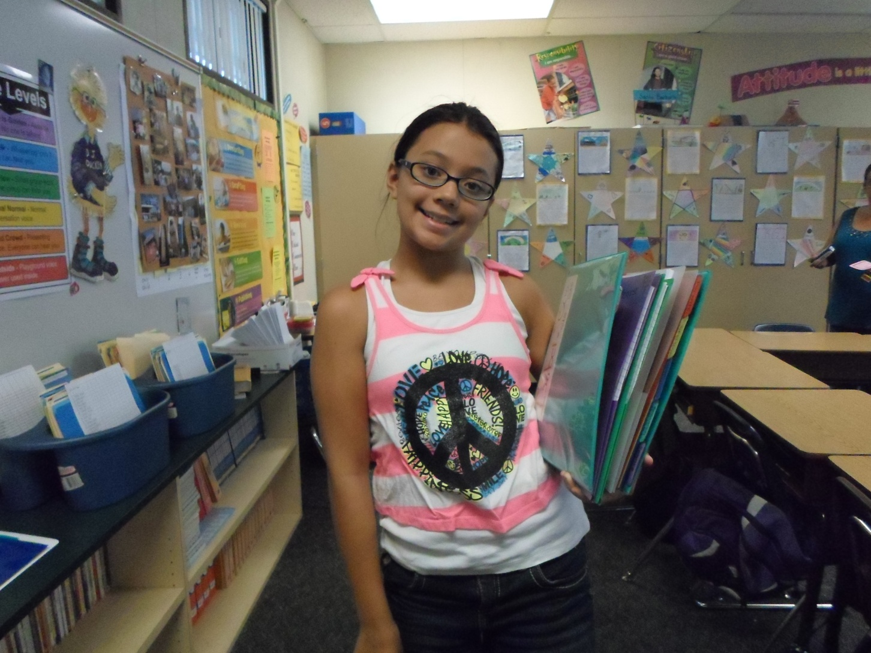
Binders can be organized and easy to carry!

Slide 9
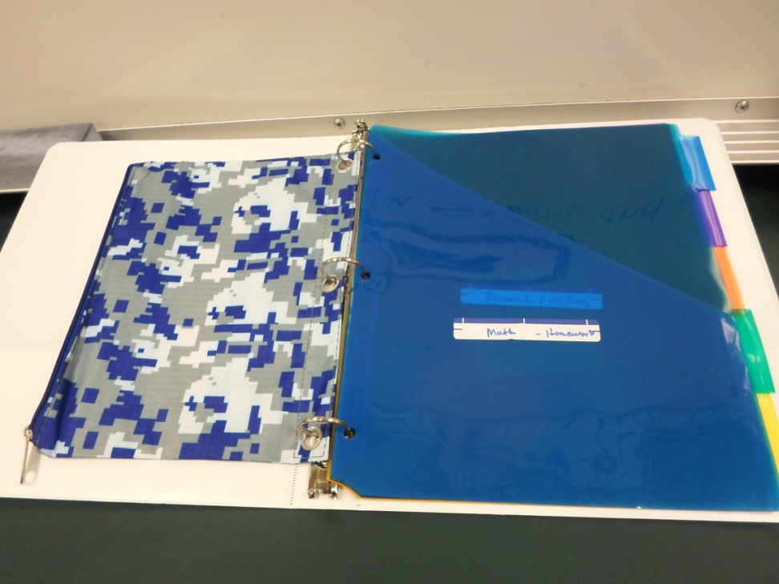
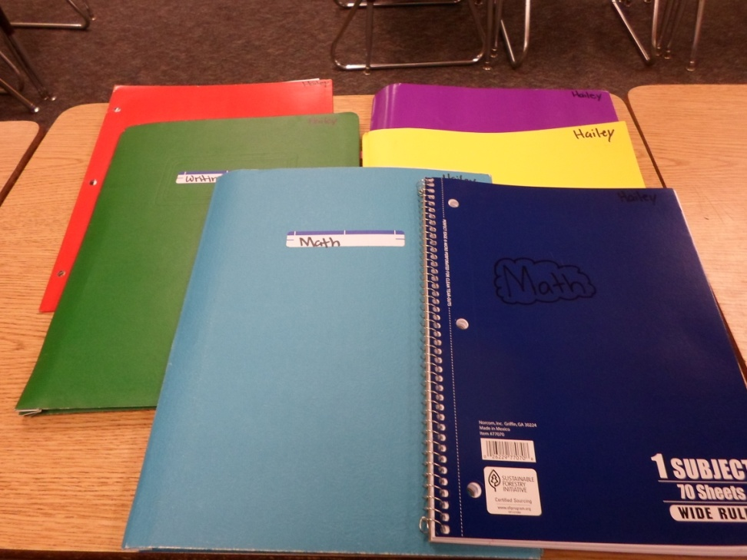
Organization
Binder and Dividers
Pocket Folders and Notebooks

Slide 10
Communication
Please check your email for notices
WebPages
Weekly Highlights – an email will be sent to you when they are updated
Email address – Please email any one or all of us with questions and concerns.
Friday folders –Weekly notices, tests, work, behavior and work completion

Slide 11
Student Led Parent Conferences
Parent Conferences - November
Students will share work samples from their portfolio with you and discuss their progress and goals.
Students
Accountability for their own learning
Learn to evaluate their own progress
Gain greater commitment to schoolwork and learning
Builds self confidence and self esteem
Encourages student/parent communication
Places responsibility on the student as well as the parent
Allows student to become actively involved

Slide 12
Homework
Homework
Homework is assigned Monday – Thursday
Homework can be found on Mrs. Melanese’s Webpage
Formula
40 minutes language arts, reading, spelling, research
20 minutes math

Slide 13

Fine Arts
Music– Monday 12:30 – 1:00
3 School Assemblies
Kick Off to Stand Up to Bullying Week – September 19
Mrs. Morone’s Drama Presentation – November
Art – Mrs. Morone Art Teacher – Once a month

Slide 14

Research Projects
Minimal help from parents
Nature’s Fury (4th and 5th)
Biography (4th and 5th)
Colonialism (5th)/Missions (4th)
Presidents (5th) Gold Rush (4th)
State Reports/State Floats(5th)
Science Fair (4th and 5th)

Slide 15

A Very Special Year!

Slide 16
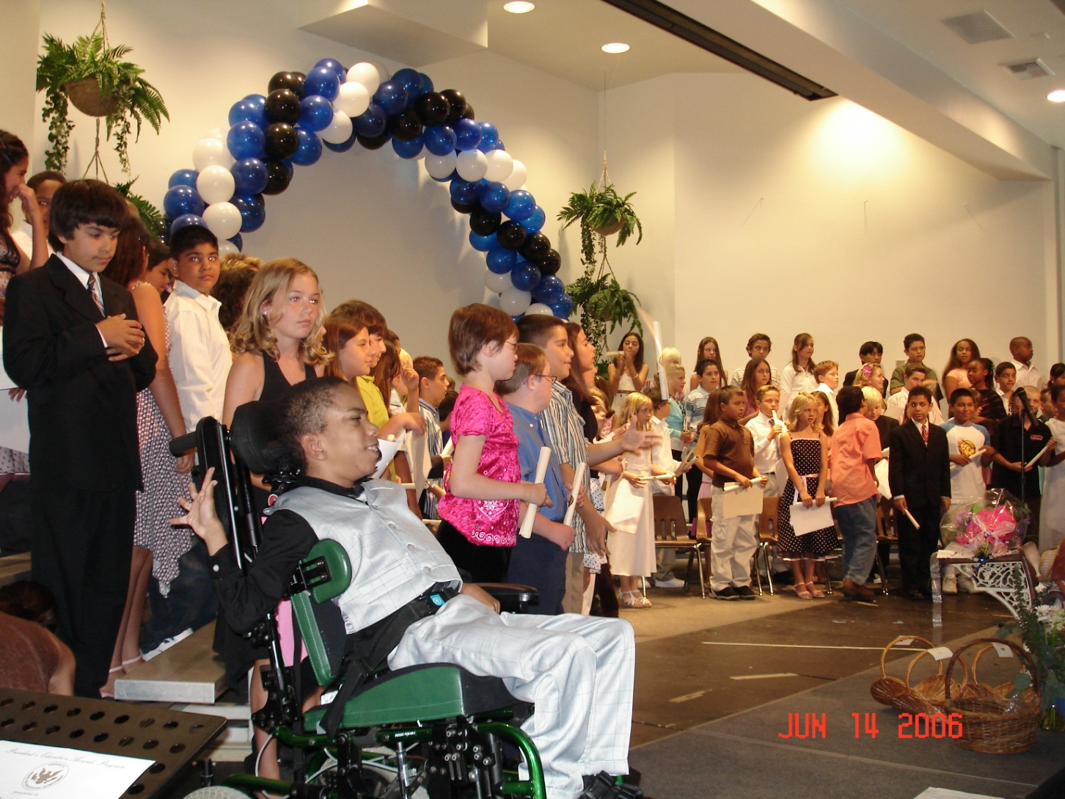
Promotion Day!

Slide 17
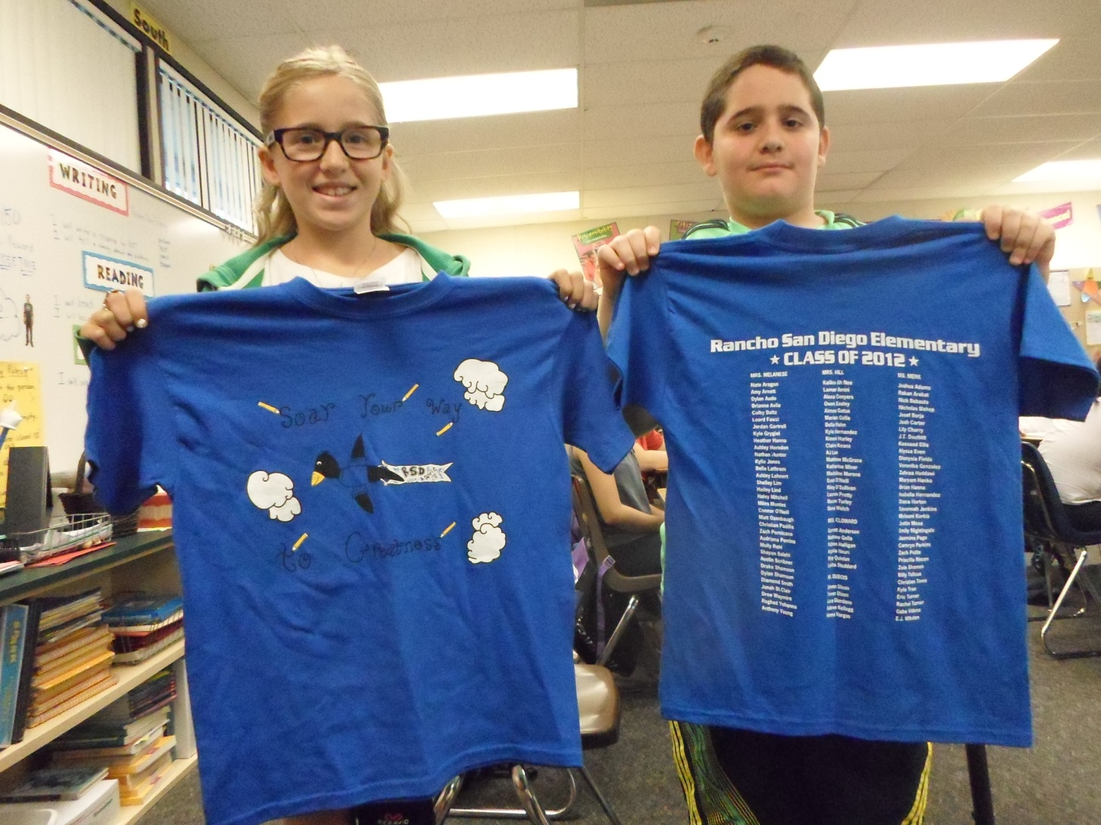
T- shirts

Slide 18
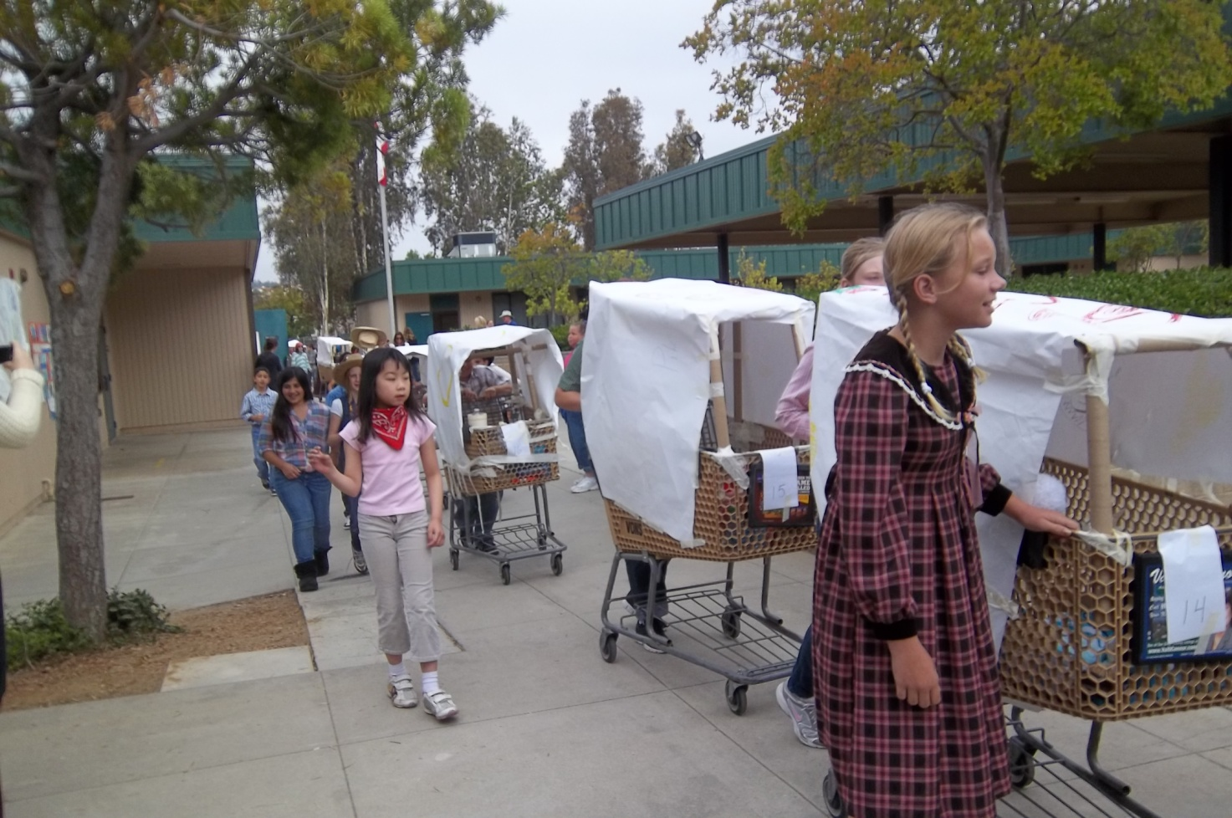
Pioneer Day

Slide 19
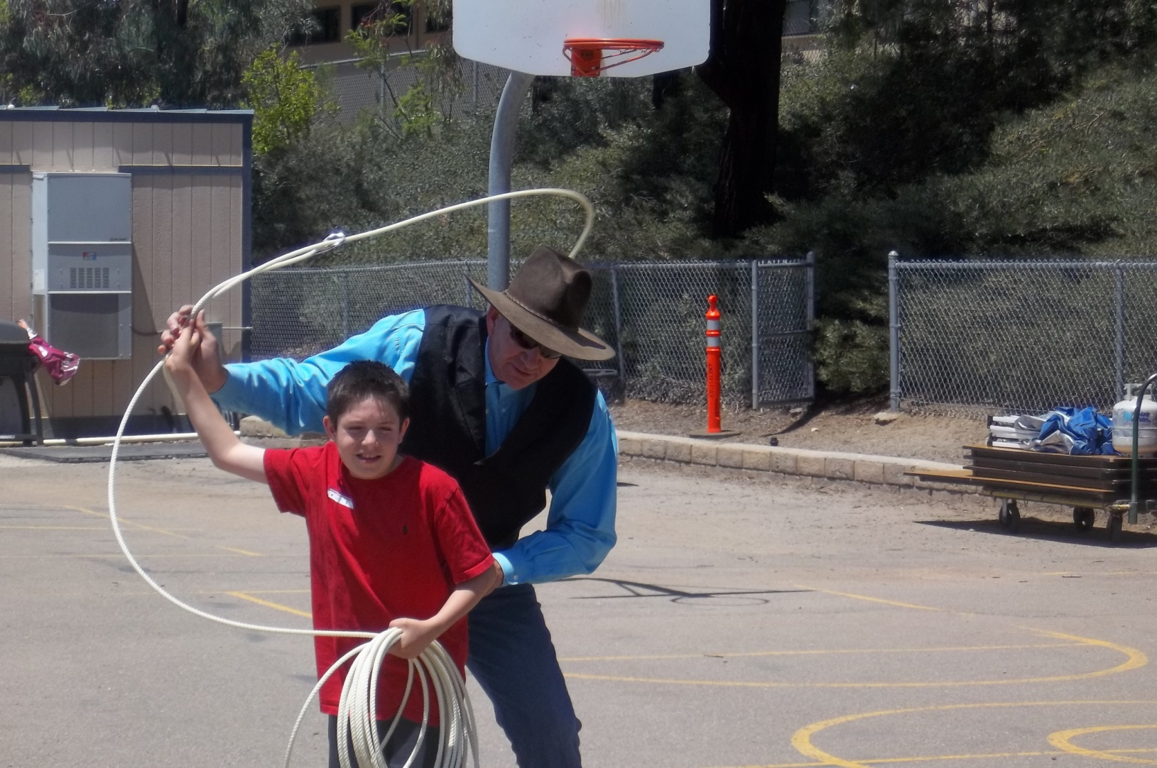
Cowboy Austel

Slide 20


Biztown is the culmination of classroom-based economic curriculum where students leave their classrooms for a simulated real-world experience at JA's experiential learning lab. Through these unique opportunities, students apply their new skills in a fun, hands-on learning environment. JA BizTown is a kid-sized city within Junior Achievement.
For Information Google “Biztown”

Slide 21
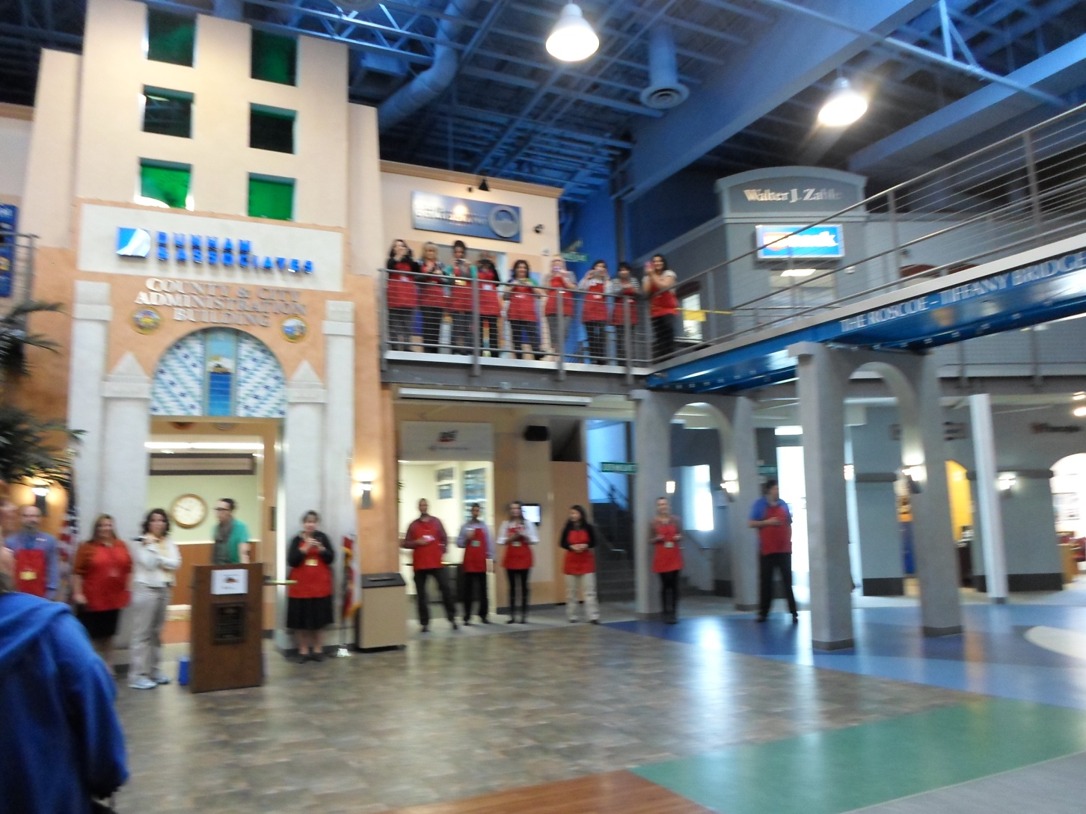
Biztown

Slide 22
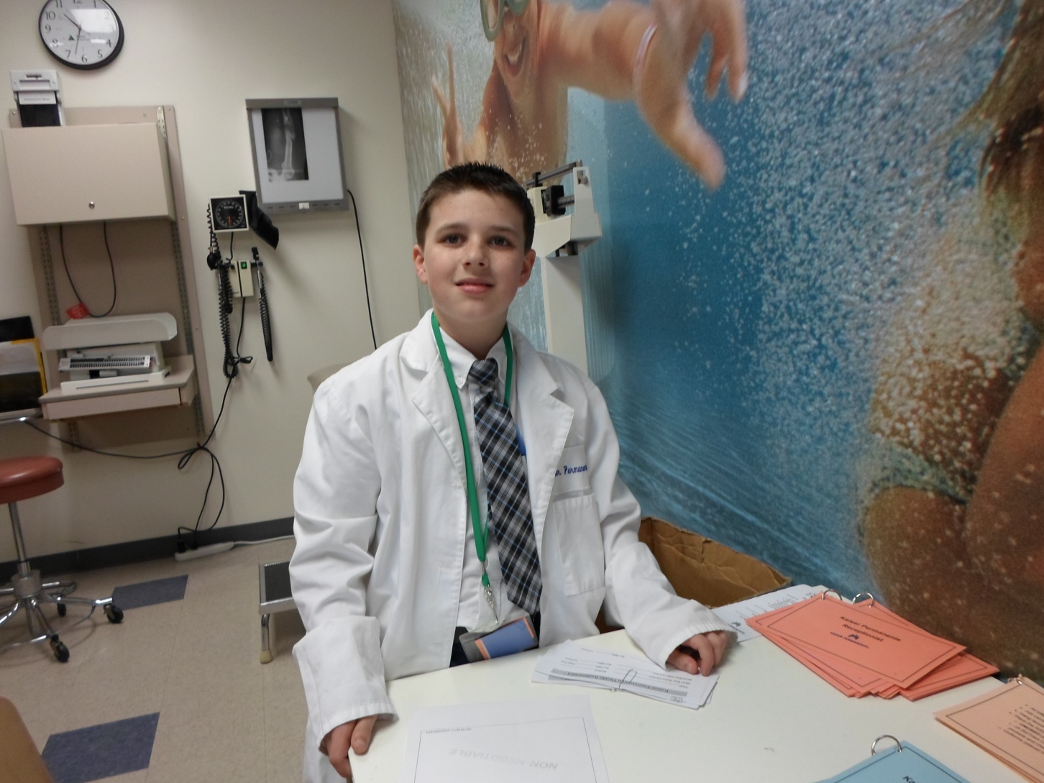
The kids run the town for a day!

Slide 23
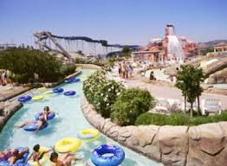
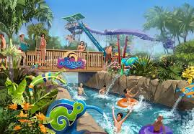

Aquatica

Slide 24
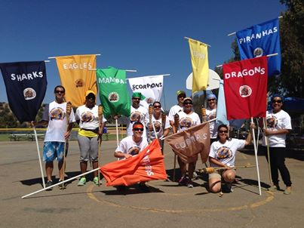
Survivor Games – Last Day of School

Slide 25
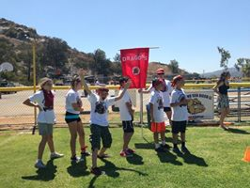
And the kids had fun too!

Slide 26
Fifth Grade Activities
Field Trips Estimated cost per child
Biz Town $20.00
Aquatica $30.00
Bus for Aquatica $ 5.00
Events
Colonial Assembly $ 3.00
Polar Express $ 2.00
Pioneer Day $ 3.00
Promotion $10.00
(flowers, balloons, gifts, programs, ribbons, last day pizza party etc.)
Survivor Games $10.00
Other
5* grade t-shirts $10.00
Drama $ 2.00
DVD $10.00
Estimated total costs for each student $105.00

Slide 27
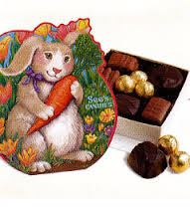

Fundraisers to help with the cost
Mixed Bags – 5th Grade gets full profit from our sales
Spring Fundraiser

Slide 28
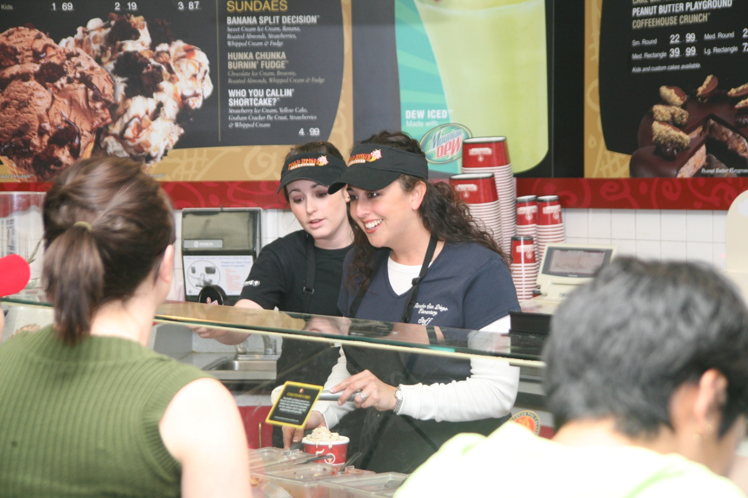
Coldstone

Slide 29

Fifth Grade Committee
We Need You!
Co-chairs – Jen Grygiel and Grace LaLicata
Sign up on the volunteer clipboards in the back.
Please come to our first fifth grade committee meeting.

Slide 30

You are now invited to your child’s homeroom.

